Slide 1
AI Based Smart Meter for Future Homes
By:
Aditya Mantri (014344395),
Nachiket Trivedi (014544933),
Nishant Jani (014496521),
Sarthak Jain (014508013)

Slide 2
Problem Statement
Utility Companies (PG&E) struggle to fulfill the electricity demands at peak hours of the day.
Techniques such as Time-of-Use policy rates being used to reduce the gap between supply and demand.
Notes:
We have considered this problem of an Optimization, where we would find a schedule for users which would give them most savings. That would naturally occur at off-peak hours where ToU pricing are comparatively lower.

Slide 3
User persona
Motivating residential people to schedule home appliances at off-peak hours with an incentive in bill reduction.
It directly helps utility companies in accurately meeting load demand at current peak hours of the day.

Slide 4
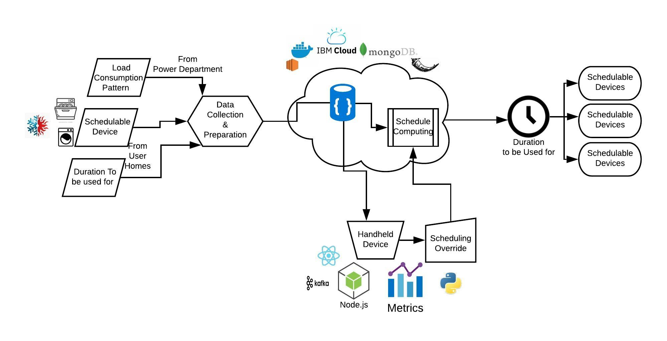
Architecture

Slide 5
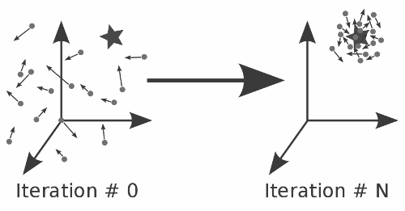
Particle Swarm Algorithm
Notes:
Our Problem Statement is to schedule user’s appliances at off-peak hours but at the same time considering the preferred timings of the user, if any. So, the schedule of appliances which will give user the most savings and most satisfaction is our optimal solution.
PSO is a computational methoda
PSO is used to deal with the non-linear nature of the problem. PSO can search very large space quickly.
PSO doesn’t require the optimization problem (low cost + high satisfaction) to be differentiable whereas Gradient Descent does.
Particle in PSO represent a potential solution to the optimization problem. Particles converge using both local best and global best positions (a schedule which gives lowest cost and maximum satisfaction till now)

Slide 6
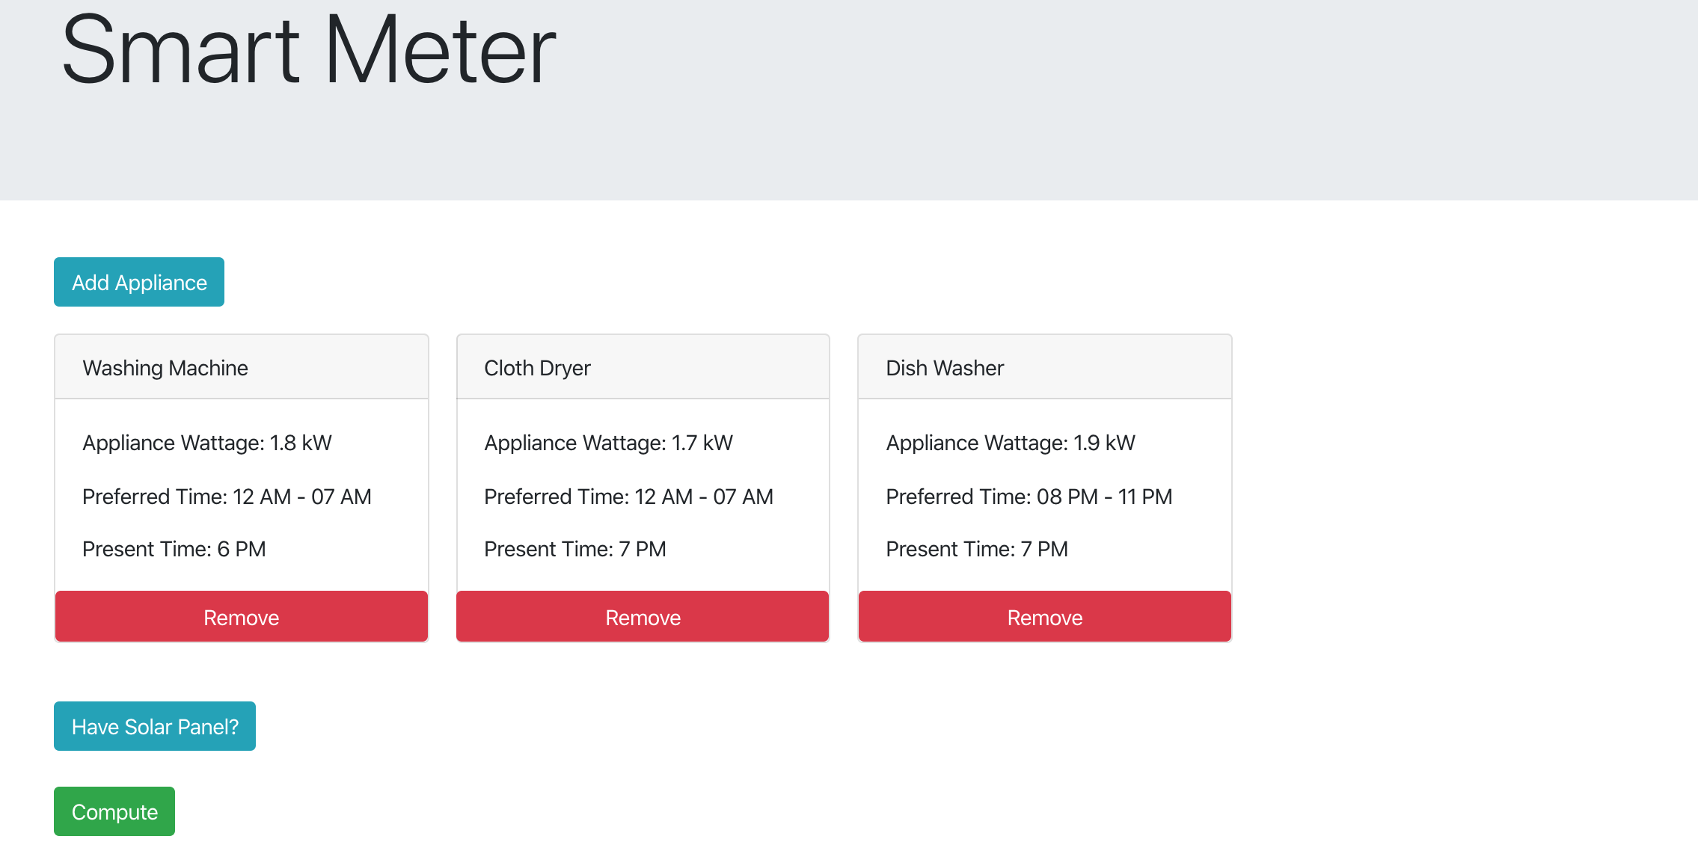
Appliance Selection

Slide 7
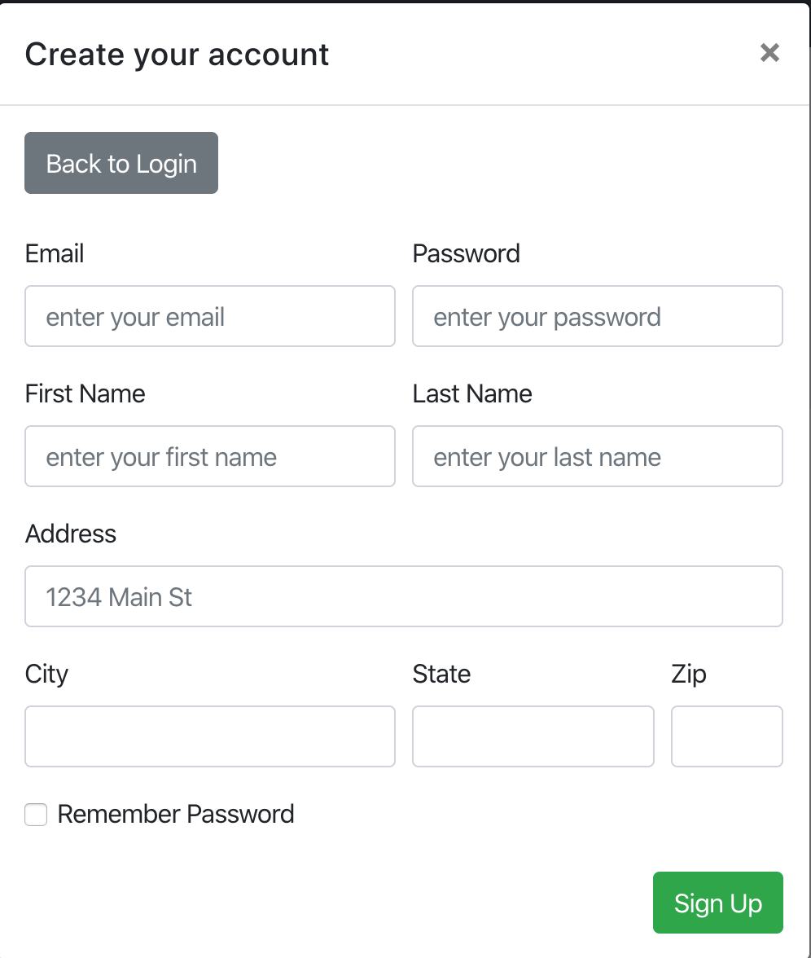
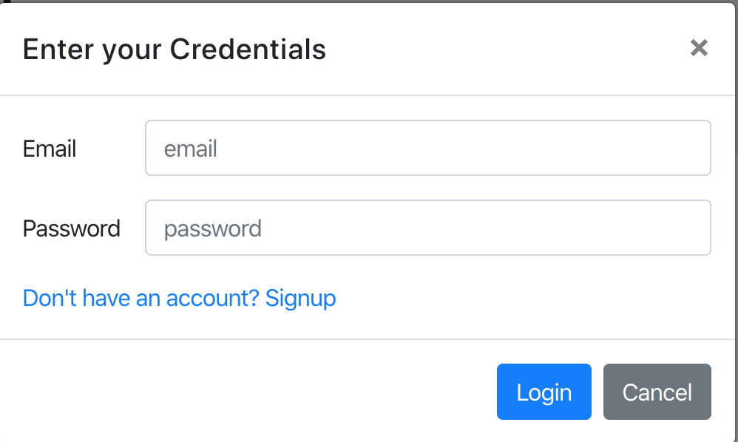
Sign-Up/Login

Slide 8
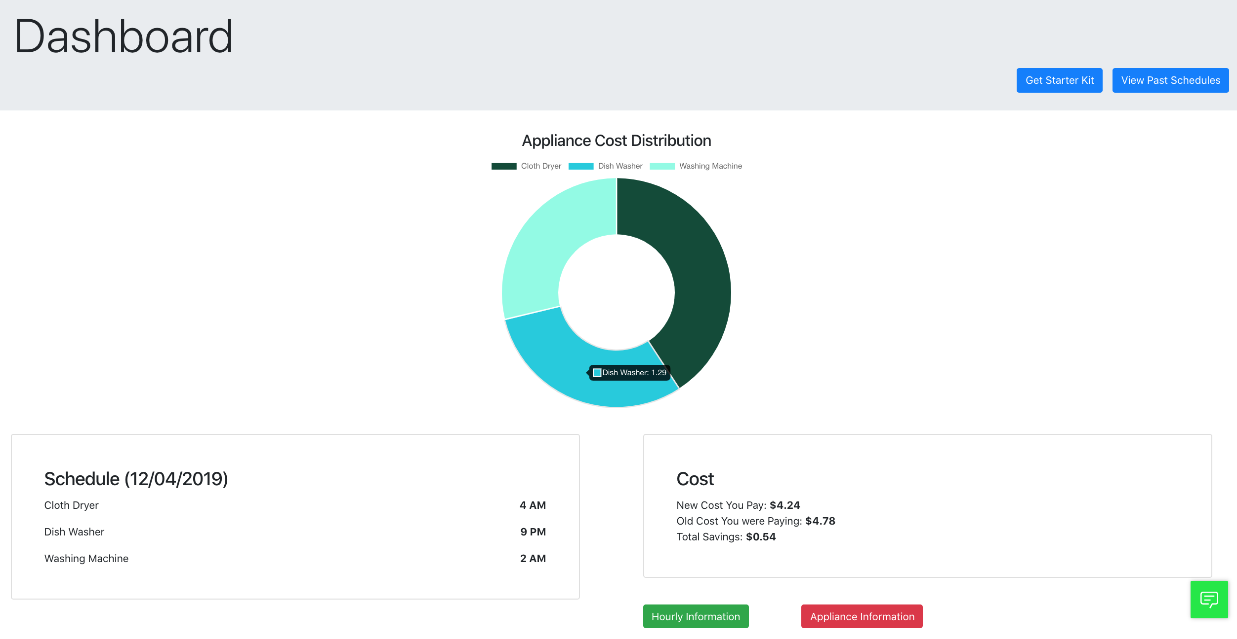
Dashboard

Slide 9
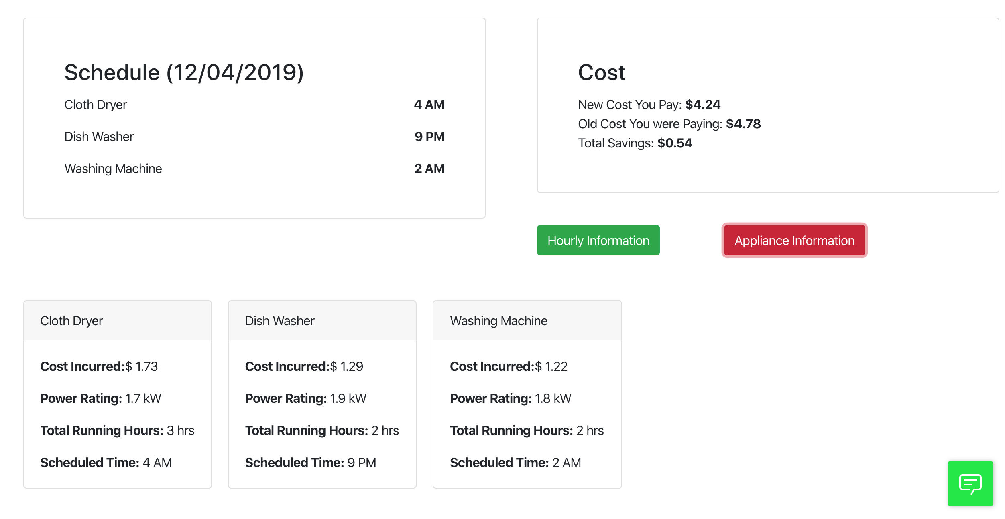
Detailed Appliance Info.

Slide 10
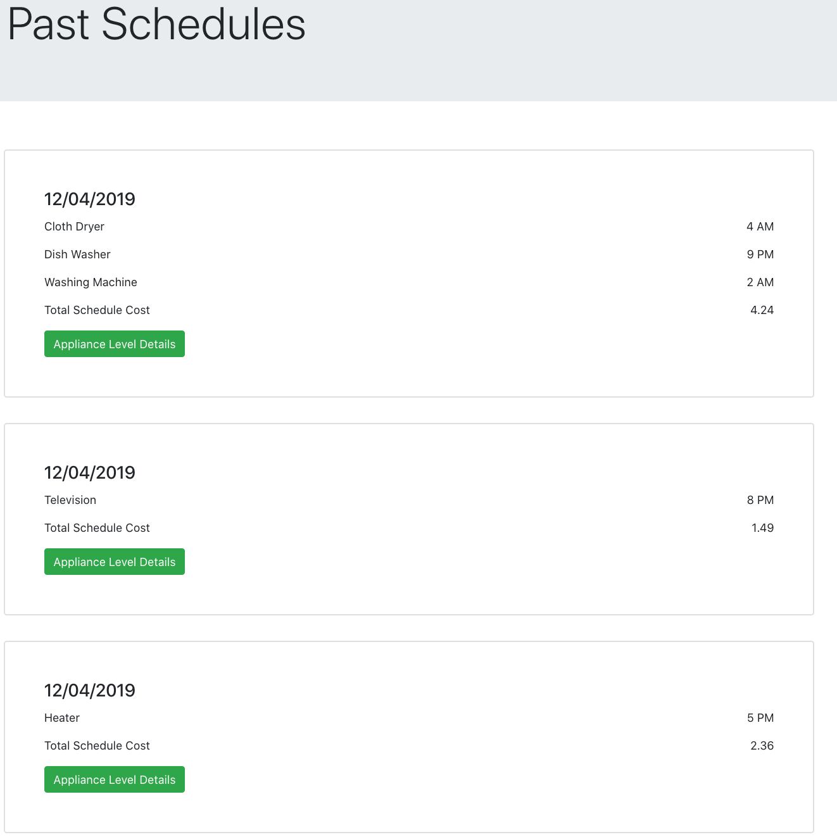
Past Schedules

Slide 11
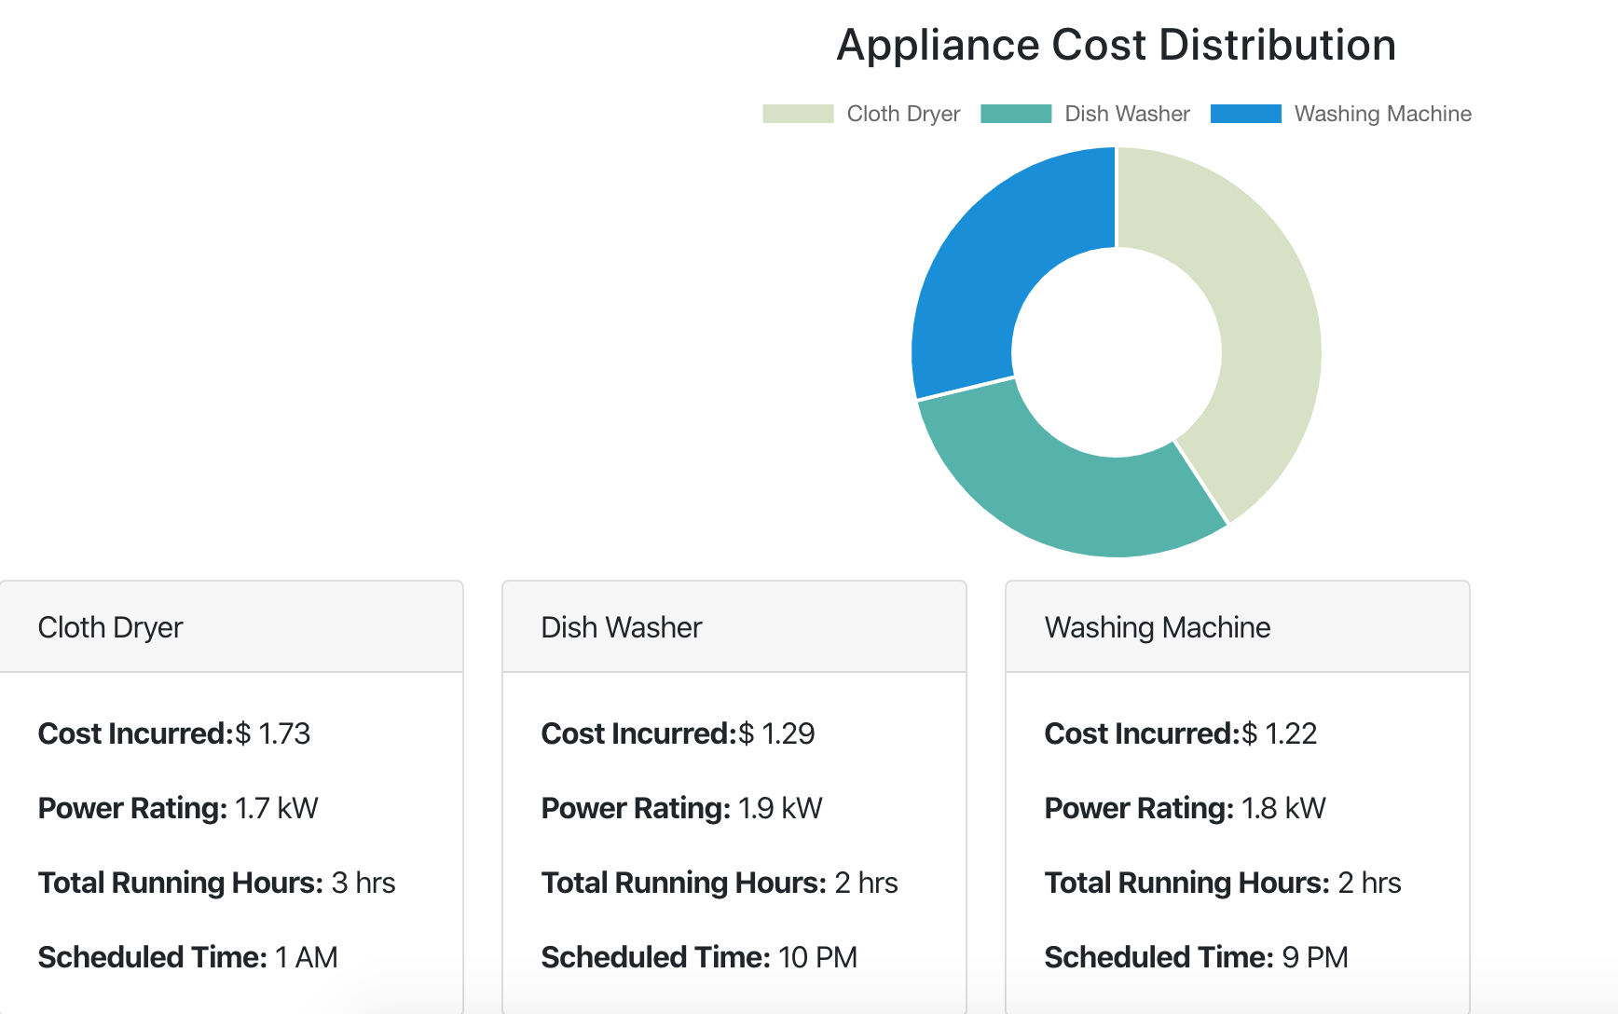
Detailed Past Info.

Slide 12
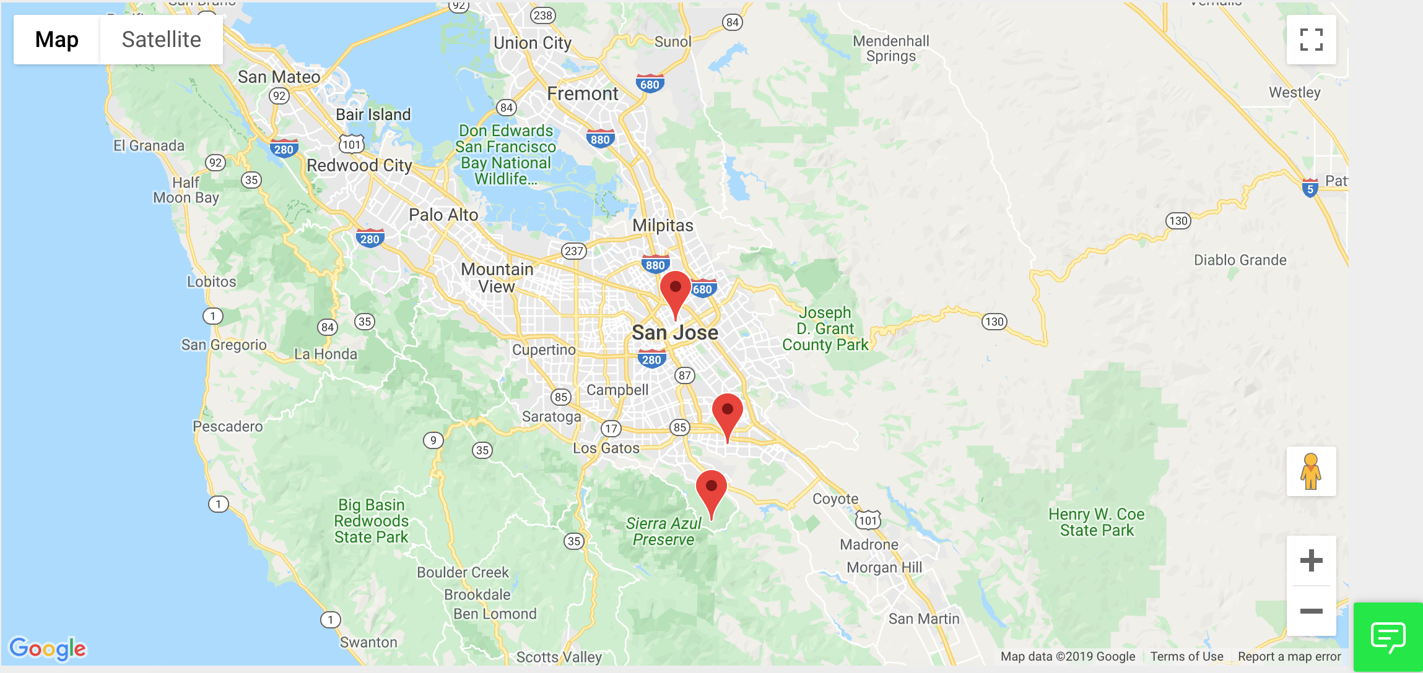
Present User’s Location

Slide 13
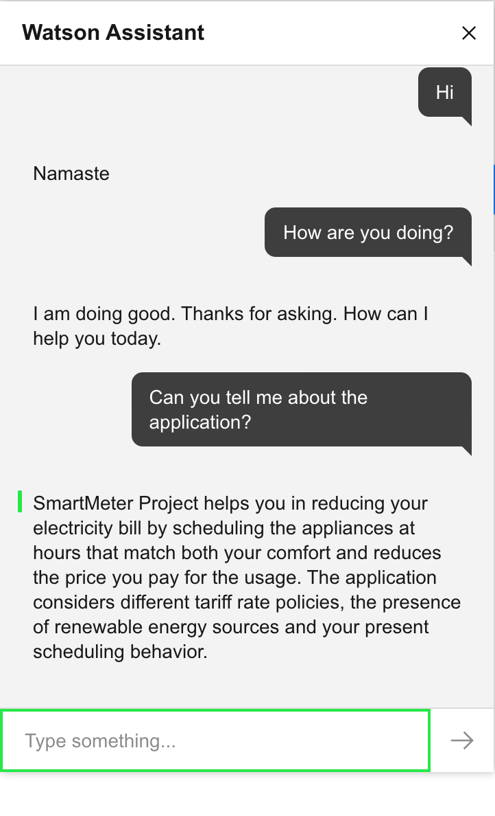
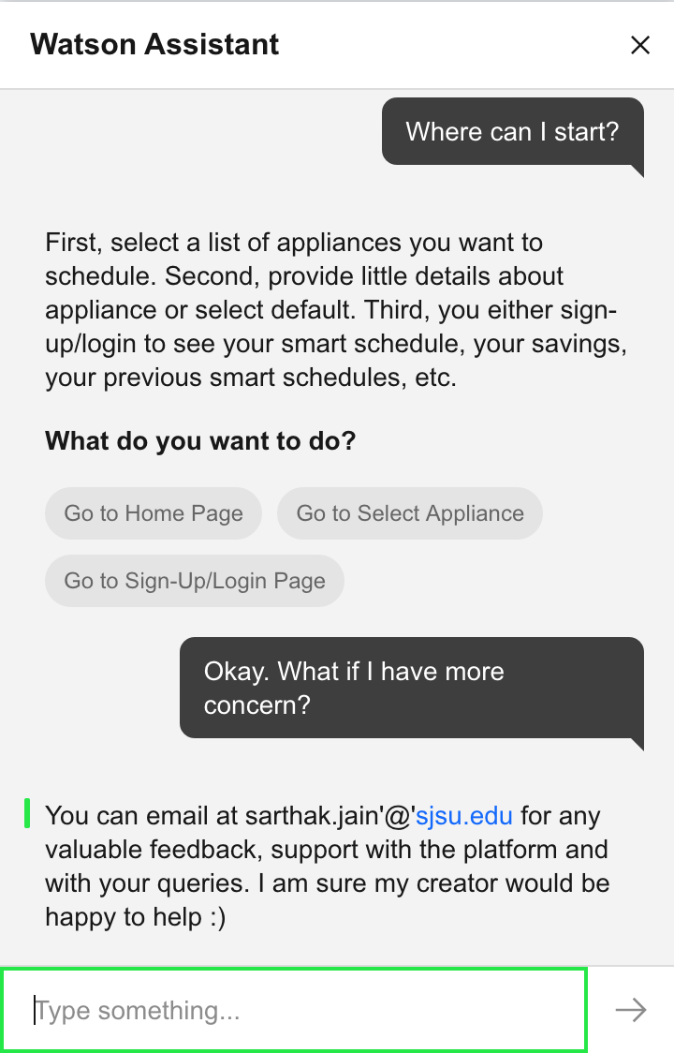
IBM Watson Assistant to Rescue

Slide 14





Technologies Used

Slide 15
Future Scope
Integrating IoT to actually schedule the appliances on the computed Time Schedule.
Implementing the concept for 2-3 houses in conjunction potentially making use of Game Theory.
Modelling each residential home behavior to provide personalized recommendations.

Slide 16
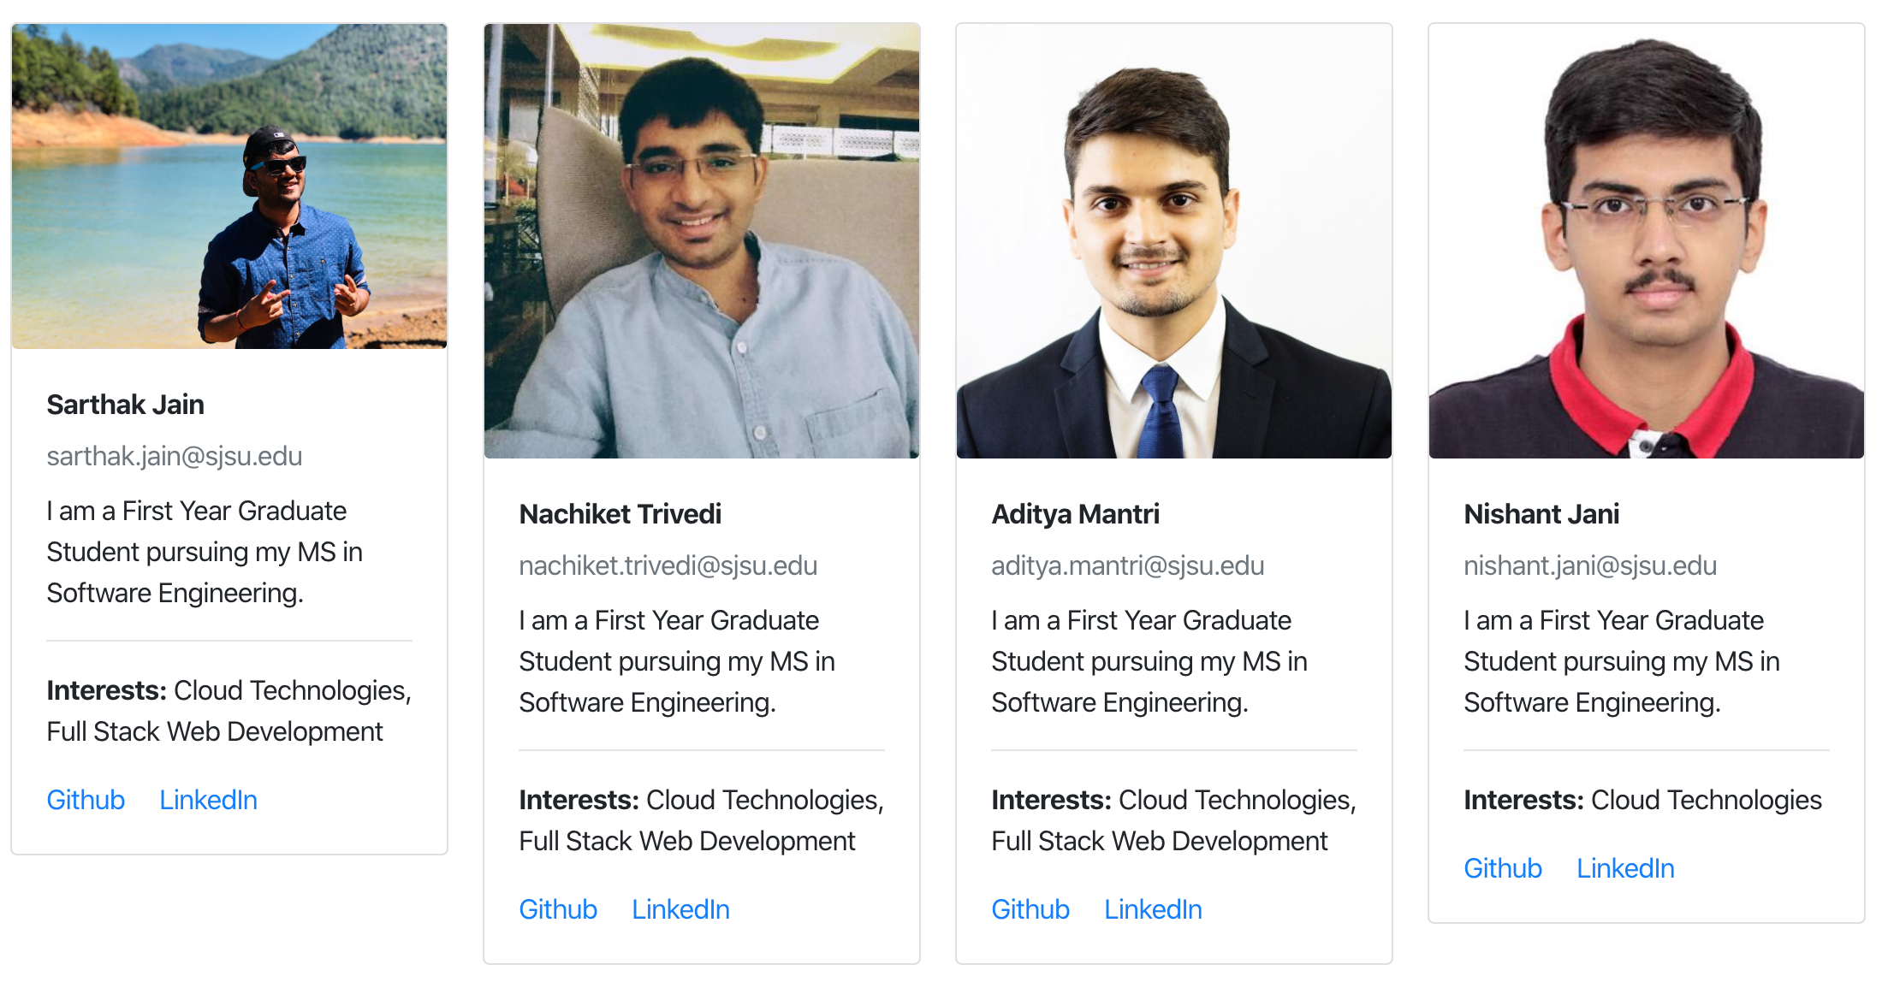
Creators

